Slide 1
WELS Ministry of Christian Giving
Notes:
The presenter may want to add their name and title to the bottom of this slide in place of or in addition to “WELS Ministry of Christian Giving.”

Slide 2
Ministry of Christian Giving mission
We encourage members to excel in the grace of giving in our Lord Jesus Christ and assist them in making planned gifts to support the gospel ministry of their congregations, synod, and WELS-affiliated ministries.
Notes:
MCG assists the COP with their responsibility to fund the Lord’s work through our synod. This funding is provided through Congregation Mission Offerings as well as direct gifts to WELS from individuals, groups, and foundations.

Slide 3
Devotional thought
“For Christ’s love compels us, because we are convinced that one died for all, and therefore all died. And he died for all, that those who live should no longer live for themselves but for him who died for them and was raised again” (2 Corinthians 5:14-15).
Notes:
Jesus’ love for us provides motivation and power for our use of his blessings and our gifts of loving thanks to him.

Slide 4
Blessings and opportunities
Notes:
First let’s look at some data to remind us of our church body’s blessings and opportunities.
We’re all aware of the slow decline in the membership of WELS that has been taking place since the peak in membership in 1990.

Slide 5
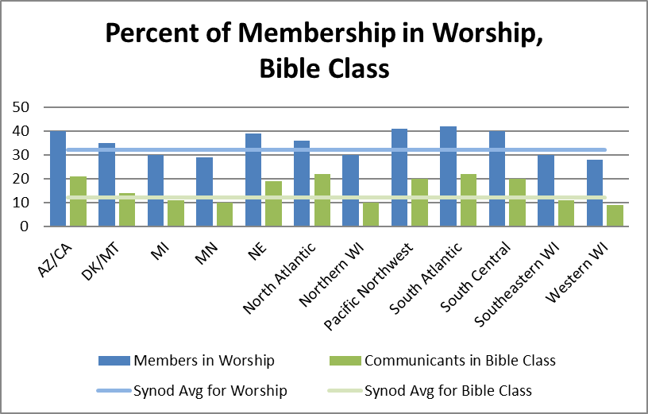
Blessings and opportunities
2021 statistics:
32% in worship
12% in Bible class
Notes:
While we slowly lose members, another challenge is that members aren’t attending worship and Bible study as much as in previous years. Worship and Bible study attendance were affected by the COVID-19 pandemic (especially in 2020) and have not rebounded to their pre-pandemic numbers (which were 41% in worship, 15% in Bible class).
With room to grow in all these areas, let’s ask our gracious Savior to increase our joy in his salvation!

Slide 6
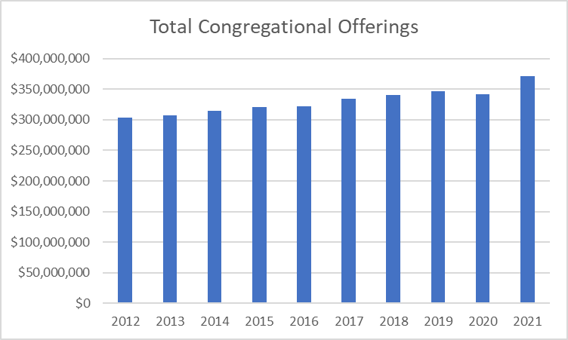
Blessings and opportunities
2021 total congregational offerings $371 million
Notes:
A blessing is that total congregational offerings have trended up each year – except during 2020 – despite declining membership and reduced worship and Bible class attendance.

Slide 7
Blessings and opportunities
Congregation Mission Offerings for 2021 were $22.68 million, which is the highest total on record. This is 4.3 percent ($938,000) more than CMO 2020 and 4.9 percent higher ($1,059,000) than projected receipts.
We praise the Lord and thank his people for these gifts!
Notes:
Especially in the last couple of years Congregation Mission Offerings have been strong. 2022 surpassed 2021 as the highest years on record for CMO.
We’re truly grateful to our heavenly Father for the wonderful thank offerings his congregations give him for the work of our church body. We also are truly grateful for WELS members’ generous participation in the gospel ministry we conduct together.

Slide 8
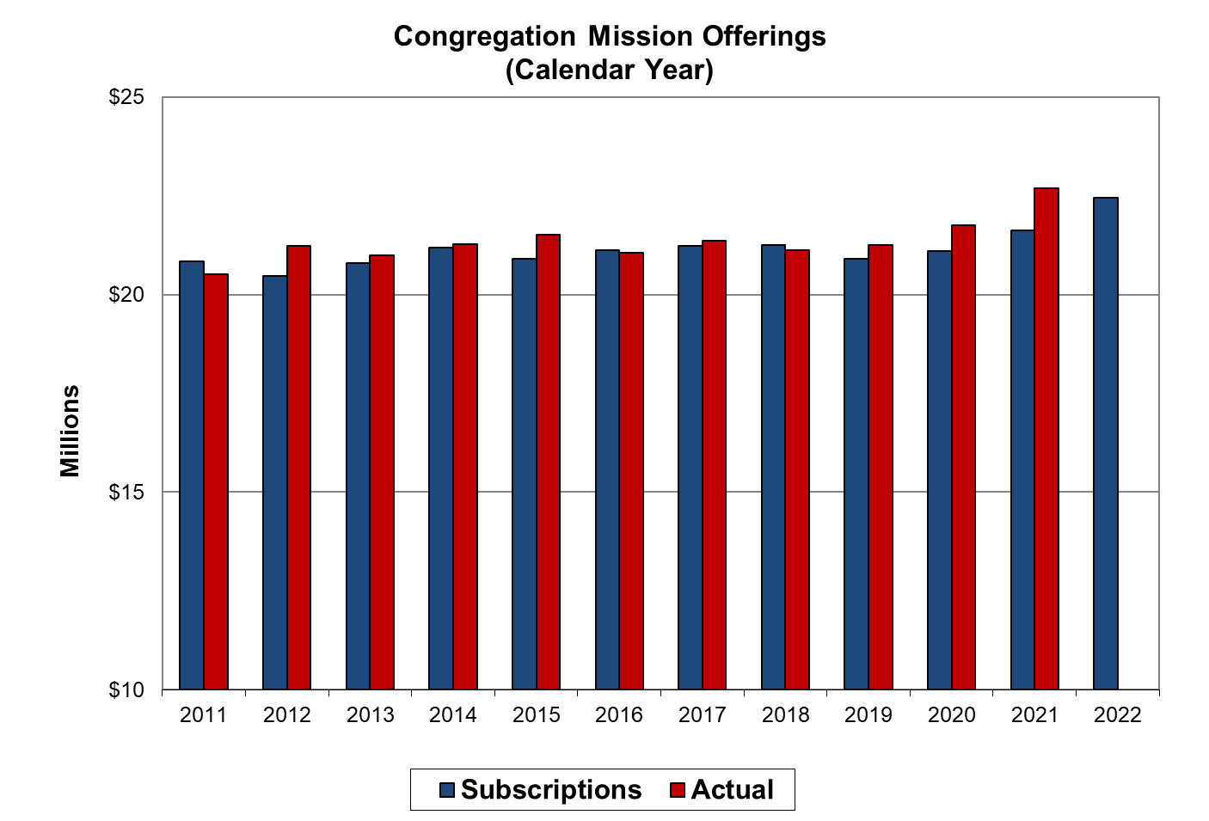
Blessings and opportunities

Slide 9
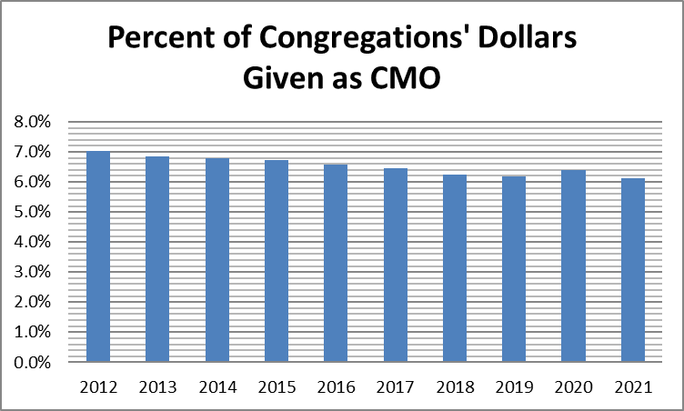
Blessings and opportunities
2.1% of personal income to offerings
6.1% of church offerings given as CMO
Notes:
Comparing offerings per communicant with our government’s latest figure for per capita income, the average percentage of income given is 2.1% (just ahead of American Christians who gave 2.0%). This has been declining slowly in recent history. The percentage of offerings that WELS congregations pass along for synod ministry compared to all offerings reported by our churches has also been slowly declining.
2.1% income figure—based on WELS 2021 Statistical Report and the U.S. Dept. of Commerce Bureau of Economic Analysis (divided per communicant giving figure for synod by U.S. per capita income).
2.0% giving by American Christians from Empty Tomb for 2019 (latest year measured).
6.1% CMO figure—based on data from WELS 2021 Statistical Report.

Slide 10
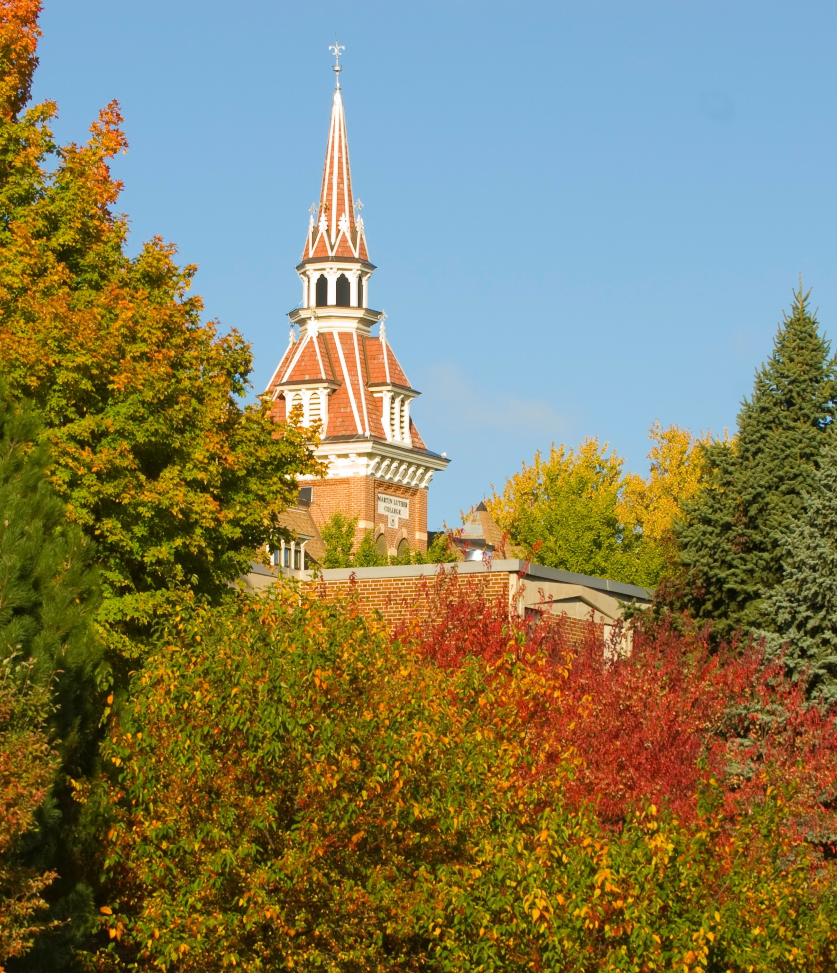
Blessings and opportunities
Equipping Christian Witnesses
July 2019-June 2022
76 prospective students identified
$9.4 million in gifts, pledges, and church commitments from 3,417 individuals and groups
Construction of Betty Kohn fieldhouse
Notes:
Ministry of Christian Giving has worked with Martin Luther College over the past three years to encourage prayers, gifts, and names of potential students. God has blessed the Equipping Christian Witnesses campaign with more prospective students and enough gifts to build the Betty Kohn fieldhouse, enhance financial aid, and to start to look at enhancing or constructing other campus facilities.

Slide 11
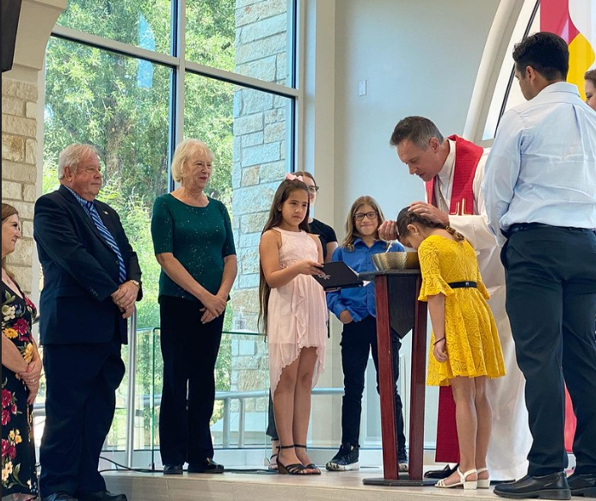
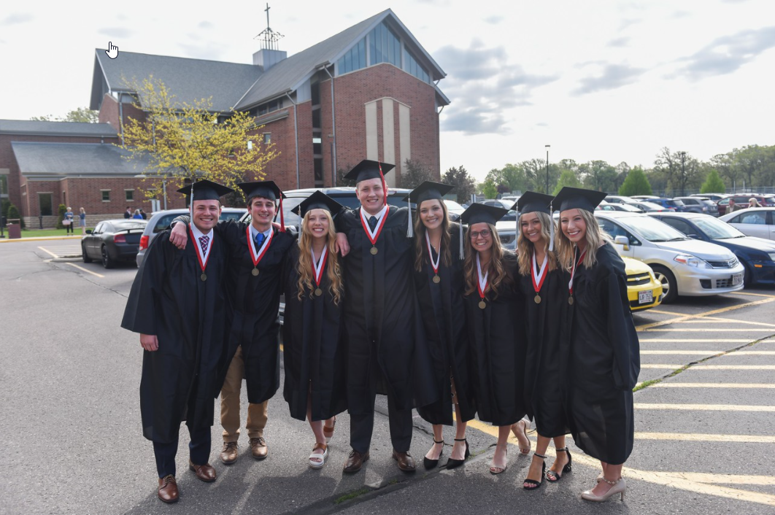
Blessings and opportunities
WELS Endowment Funds
By the grace of Jesus we have received $103 million in gifts and expectancies since 2005 and will distribute around $1 million in July from the WELS Missions and Ministerial Education Endowment Funds!
Notes:
At the 2005 synod convention delegates voted to endorse the synod’s plan to build up two $150 million dollar endowment funds, one for ministerial education and one for missions. As of May 20, the WELS Ministerial Education Endowment Fund has $14.4 million with $31.2 million in expectancies. The WELS Missions Endowment Fund has $18.2 million with $39.5 million in expectancies.

Slide 12
Congregation Mission Offerings
CMO subscriptions for 2022 point to a decrease of 1.6 percent from 2021 actual offerings.
Through April, offerings total $7.08 million, which is 4.1 percent more than 2021 CMO for the same period and 9.0 percent higher than 2022 projected receipts.
We praise the Lord and thank his people for these gifts and commitments!
Notes:
I mentioned how the last couple of years of CMO were especially strong – and 2022 offerings continue to exceed expectations!

Slide 13
Congregation Mission Offerings
When setting CMO, aim for ten percent of offerings. If at or above this goal, encourage your congregation to maintain its generous support or consider increasing it as you’re able with God’s blessing.
“For if the willingness is there, the gift is acceptable according to what one has, not according to what one does not have” (2 Corinthians 8:12).
“Excel in this grace of giving. . . . For you know the grace of our Lord Jesus Christ” (2 Corinthians 8:7,9).
Notes:
When setting CMO, we encourage all our congregations to joyfully consider designating ten+ percent of general offerings for CMO. The reason? Because you know the grace of our Lord Jesus Christ! Also, it’s the foundational source of synod support.

Slide 14
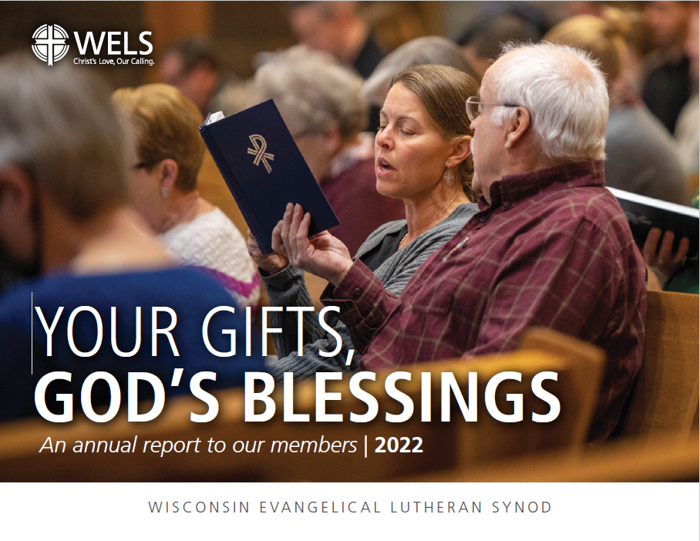
Congregation Mission Offerings
WELS Connection
Together e-newsletter
Forward in Christ
Annual Report (includes PowerPoint)
Annual CMO setting materials
Notes:
Please note these resources that are designed to keep you and others informed about how CMO and unrestricted IMO are being used to proclaim the firm foundation of God’s Word around the world.

Slide 15
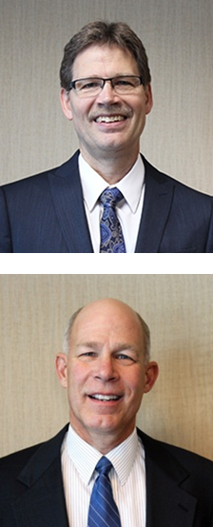
Individual offerings
Your current giving counselors:
Rev. Phil Gieschen
Phone: 715-891-0034
E-mail: phil.gieschen@wels.net
Rev. Phil Spaude
Phone: 612-720-1323
E-mail: philip.spaude@wels.net
Notes:
WELS Ministry of Christian giving has 12 giving counselors available across the country (two per district with different specialties) to provide free assistance with gifts to your congregation, WELS, or another WELS ministry. Here are the giving counselors serving our district.

Slide 16
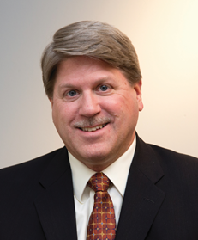
Individual offerings
Your deferred giving counselor:
Rev. Michael Hatzung
Phone: 612-280-4491
E-mail: michael.hatzung@wels.net
Notes:
WELS Ministry of Christian giving has 12 giving counselors available across the country (two per district with different specialties) to provide free assistance with gifts to your congregation, WELS, or another WELS ministry. Here are the giving counselors serving our district.

Slide 17
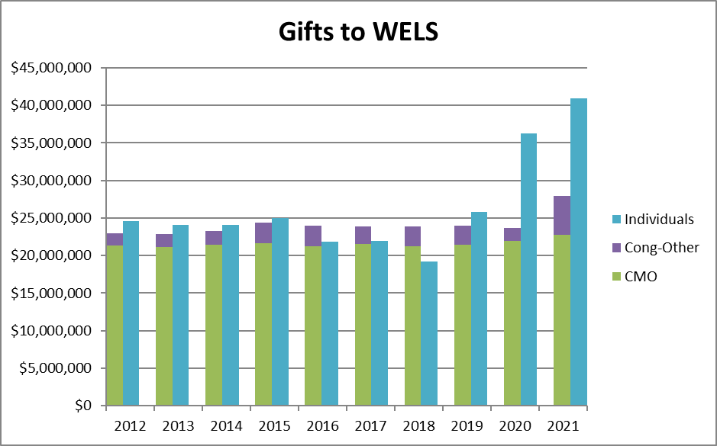
Individual offerings
Notes:
This chart shows individual offerings compared to congregational offerings per the WELS Statistical Report (2021). Individual offerings include gifts from individuals, foundations, closed congregations, etc. What amazing evidence of joyful generosity, particularly in the past couple of years.

Slide 18
Individual offerings
In fiscal year 2021-22 (through May), WELS Christian giving counselors (11.9 full-time equivalents) conducted 1,332 substantive meetings with WELS families, offered 86 group presentations, and arranged 159 major gifts and expectancies with a value of $28.4 million. They have nurtured $10.9 million in immediate gifts and $19.2 million in new/revised deferred expectancies for congregations, WELS, and WELS-affiliated ministries. To God be the glory!
Notes:
Jesus is blessing our service to his people and him!

Slide 19
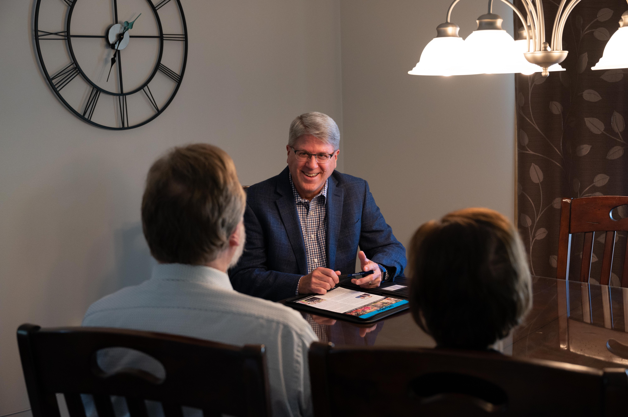
Individual offerings
Enhancing our service to individuals
Continue Christ-centered, relationship-based, free, confidential help
Increased focus on connecting donors’ interests with our areas of ministry
Additional assistance with major gifts of assets according to donors’ interests and abilities
Intentionally nurturing donors to consider supporting Christ’s work now and through their wills as the Lord has blessed them
Notes:
The Conference of Presidents (COP) contracted with consulting firm BWF in 2020 to provide a “top to bottom review of WELS MCG.” BWF commended MCG and its partners for their diligent, mission-focused service to donors. At the same time, BWF has guided us toward enhanced service to individuals. In addition to these bullets, the new strategy includes additional MCG office staff, nurturing mid-level donors, segmenting appeals, and establishing an advisory group of WELS leaders and active donors.

Slide 20
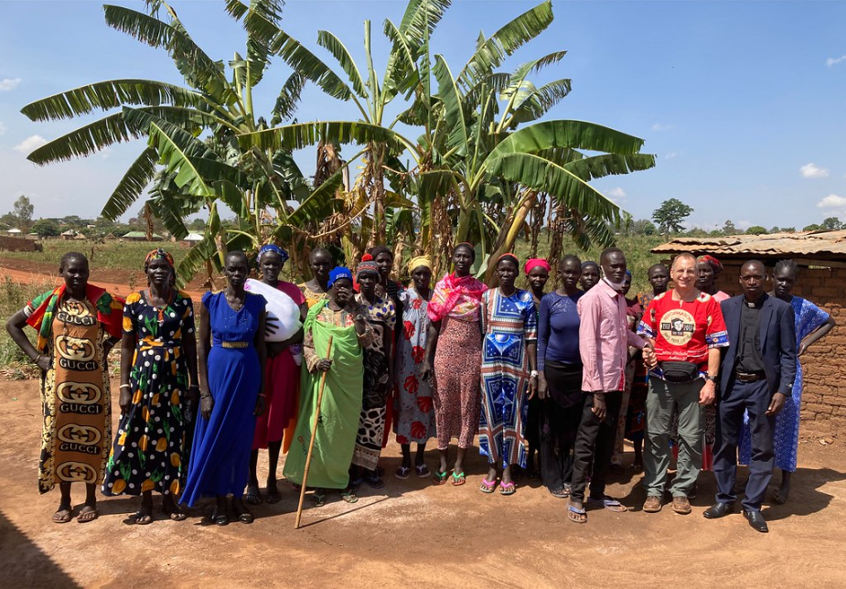
Individual offerings
IRA charitable distributions
Those 70.5 or older can make tax-free gifts to ministry from their IRAs.
Consider directing required minimum distributions to ministry to save on taxes, then using the cash you would have given to charity for other needs.
wels.net/qcd
Notes:
The following slides include ways that members can support their congregations and synod.
Qualified charitable distributions from individual retirement accounts have been a popular way to give in recent years. If you are 70.5 and do not need the required minimum distributions that you receive from your IRA, consider directing those to save on taxes, then use the cash you would have given to charity for other needs. (There’s a $100,000 limit per IRA holder each year.)
A unique IRA QCD gift acknowledgement letter is available from WELS Foundation at wels.net/qcd.

Slide 21
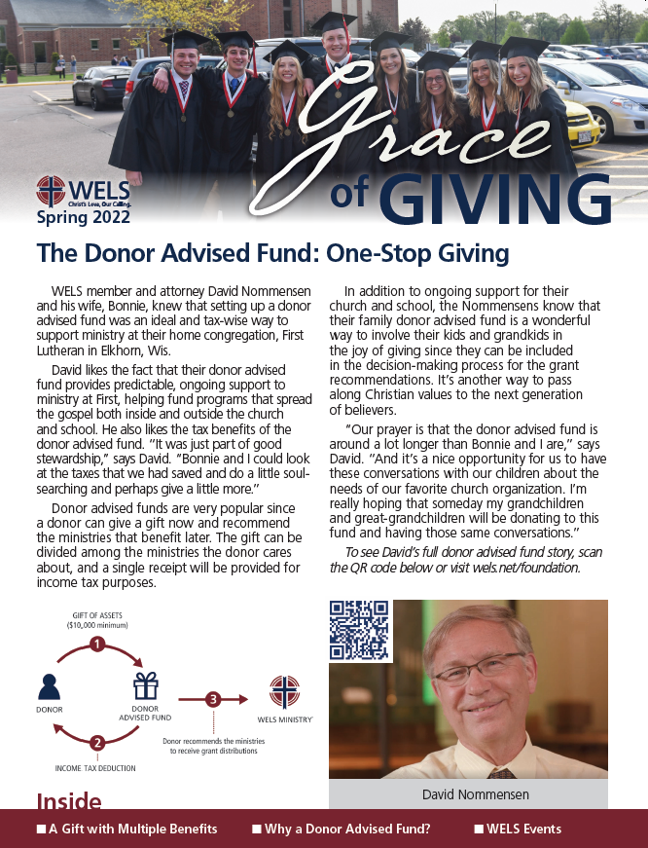
Individual offerings
Grace of Giving
Newsletter from WELS Ministry of Christian Giving and WELS Foundation with ministry updates and planned giving options
Notes:
We send the Grace of Giving newsletter to inform people about different ways that WELS members may use to offer special gifts to the ministries that they love.

Slide 22
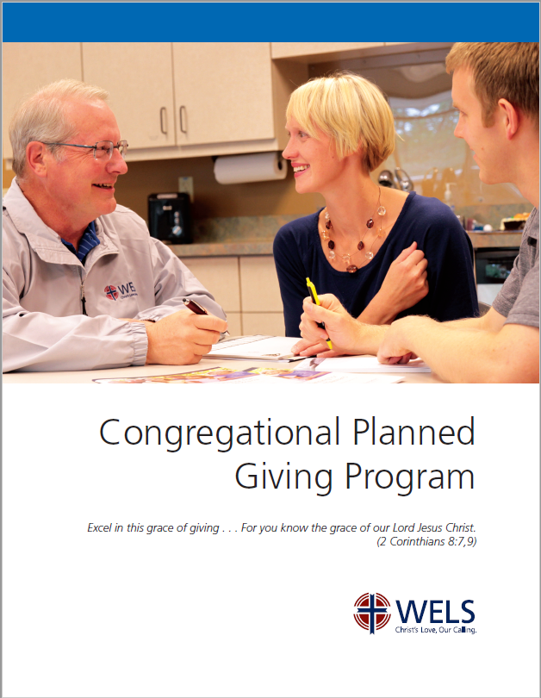
Resources
Congregational Planned Giving
Encourage planned giving in your church using synod resources and your local giving counselor
wels.net/plannedgivingprogram
Notes:
Many churches may have experienced a challenging financial outlook that is eased by an unexpected bequest from a member who went to be with Jesus. Churches can work now to inform members of these giving opportunities so that planned gifts continue to arrive for years to come. WELS Ministry of Christian Giving provides this planned giving program manual with “quick starts” to promoting planned giving and setting up an endowment as well as more complex options.

Slide 23

Resources
Stewardship Toolbox
“Mission prayers” for various ministries
“Stewardship by the Lectionary” devotionals based on weekly readings share God’s stewardship truths according to the pericope
mcg.welsrc.net
Notes:
Every other month church leaders can find two months’ worth of Stewardship Toolbox resources at MCG’s resource collection online, mcg.welsrc.net.
“Mission prayers” allow the congregation or individuals to learn about and pray for different areas of our synod ministry.
“Stewardship by the Lectionary” includes short stewardship devotions based on weekly readings from the lectionary – a good way to encourage members each week with how they can fully put their trust in our gracious God.

Slide 24
Scriptural encouragement
“Therefore, brothers and sisters, since we have confidence to enter the Most Holy Place by the blood of Jesus…Let us hold unswervingly to the hope we profess, for he who promised is faithful. And let us consider how we may spur one another on toward love and good deeds, not giving up meeting together, as some are in the habit of doing, but encouraging one another—and all the more as you see the Day approaching” (Hebrews 10:19, 23-25).
Notes:
As we stand in Jesus and the sure hope he gives us, we may eagerly perform the love and good deeds he prepared in advance for us to do and encourage one another in every situation since we know the Day of his glorious return is approaching. God bless our ongoing work in Christ!

Slide 25
Thank you!
WELS Ministry of Christian Giving
mcg@wels.net
800-827-5482
Notes:
Thank you for your time today and your partnership in Christ’s kingdom. The grace of the Lord Jesus be with you!

